Slide 1
Australia
James Kelly
Chief Technology Officer, Connections Travel Group

Slide 2










Who we are
We enrich lives through human connection and the power of travel.
Powered by UBUNTU.
Connections Travel Group is Australia’s largest privately owned travel management and events company. The proud parent of CT Connections, Totem Connections and Edge Connections. Since 2000, we’ve connected Australians with destinations near and far through corporate travel, unforgettable events, and luxury leisure expertise.
We’re here to help people stay connected – wherever they may be.
Brisbane
133 Staff
Perth
Sydney
Adelaide
Corporate Travel
Management
Leisure
Travel
Incentives, Conferences
& Events
Melbourne
Connections Travel Group - © Copyright 2025

Slide 3

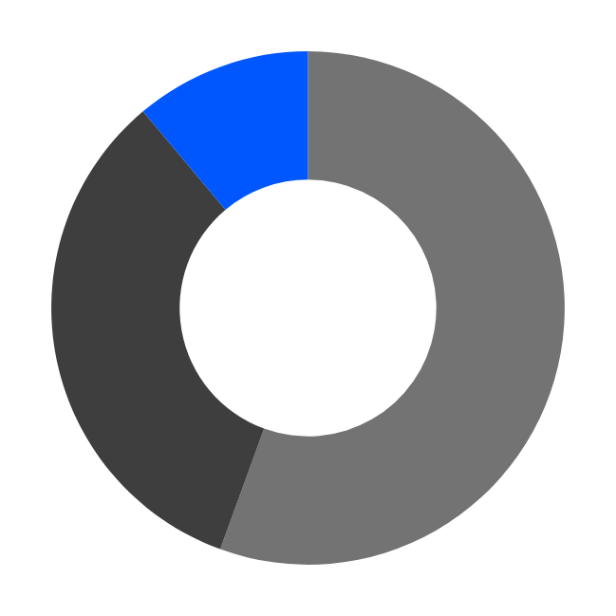


CTG Uniquely Placed in the TMC Landscape
Legacy Global TMCs
  Expertise in strategy delivery and client cost-saving initiatives
  Process Driven (call-centre)
  Limited empowerment
  Limited flexibility
  Proprietary Technology not always compatible with client ‘needs’
Experts in strategy
Demonstrated cost savings & ROI
Flexible, highly personalized service
Structured for Responsibility
Scalable with growth and for supplier negotiations
Adaptable to client needs through local ownership and Australian Focus
Global Network of like-minded agencies
Innovative agnostic technology
Boutique TMCs
  Personalised service
  Good Relationships
  Technology can be a major barrier
  Limited Diversity geographically & in industry
  Limited Expertise in Strategy
Value Proposition
  Highly personalised service & experience (best in market)
  Trust & Transparency
  Innovative agnostic technology & solutions
  Valuable through ‘Return on Investment’ (ROI)
Connections Travel Group - © Copyright 2025

Slide 4


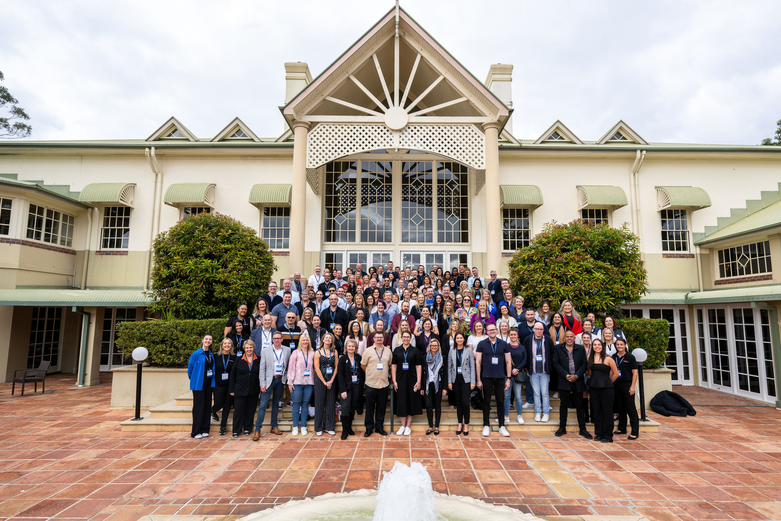
Powered by the industry’s best
Our front lines are epic; behind the scenes it’s legendary!
Meet the Experts:
Nationwide Operations
Local, experienced & in-house After-hours Team
Tech & Implementation
Account Management
People & Culture and Finance
Marketing (Creative & Digital)
Data Analysis
Leisure Team
Incentives, Conferences & Events
Supplier Relations & Product
Connections Travel Group - © Copyright 2025

Slide 5


