Slide 1
BELGIUM
Danny Vanderghinste
Managing Partner – Triton Travel

Slide 2
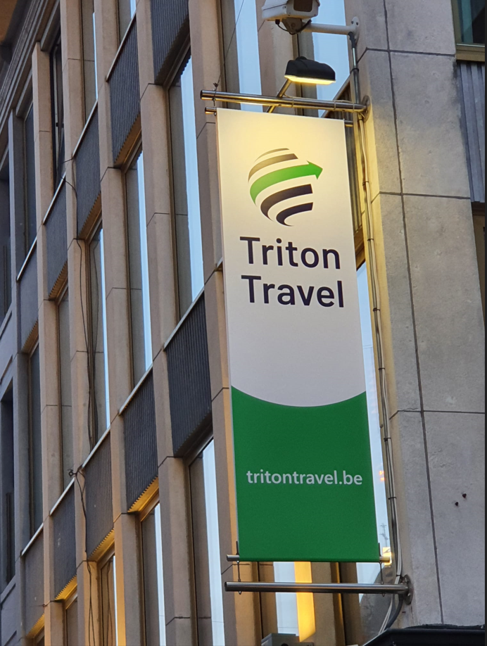

Business Travel
Groups & Incentives
Leisure Travel
Located in Mechelen, between Brussels and Antwerp
Born 25 years ago, currently 21 heroes with >300 years travel experience
Turnover 28 mio€, serving >250 organisations in almost every sector and industry
Proud member of Business Travel Partners (BTP), Belgian Travel Alliance (BTA), GlobalStar Travel Management
Our USP’s
Every staff member multilingual
Specialised in multi-country clients
Full product & service basket
Hybrid solution approach = client-oriented balance offline/online
Extended agility regarding Finance & Administration – prepaid invoicing
State-of-the-art Online Booking Tool: myTriton (E)

